Slide 1
Computer Organization and Architecture
Topic: Execution of Complete Instruction
By
Upendra Mishra
(M. Tech., Ph.D.*)
KIET Group of Institutions

Slide 2
Prerequisites
Instruction Cycle
Sub Cycle

Slide 3
Fundamental Concepts
Processor fetches one instruction at a time, and perform the operation specified.
Instructions are fetched from successive memory locations until a branch or a jump
instruction is encountered.
Processor keeps track of the address of the memory location containing the next
instruction to be fetched using Program Counter (PC).
Instruction Register (IR)

Slide 4
Executing an Instruction
Fetch the contents of the memory location pointed to by the PC. The contents of this
location are loaded into the IR (fetch phase).
IR ← [[PC]]
Assuming that the memory is byte addressable, increment the contents of the PC by 4
(fetch phase).
PC ← [PC] + 4
Carry out the actions specified by the instruction in the IR (execution phase).

Slide 5
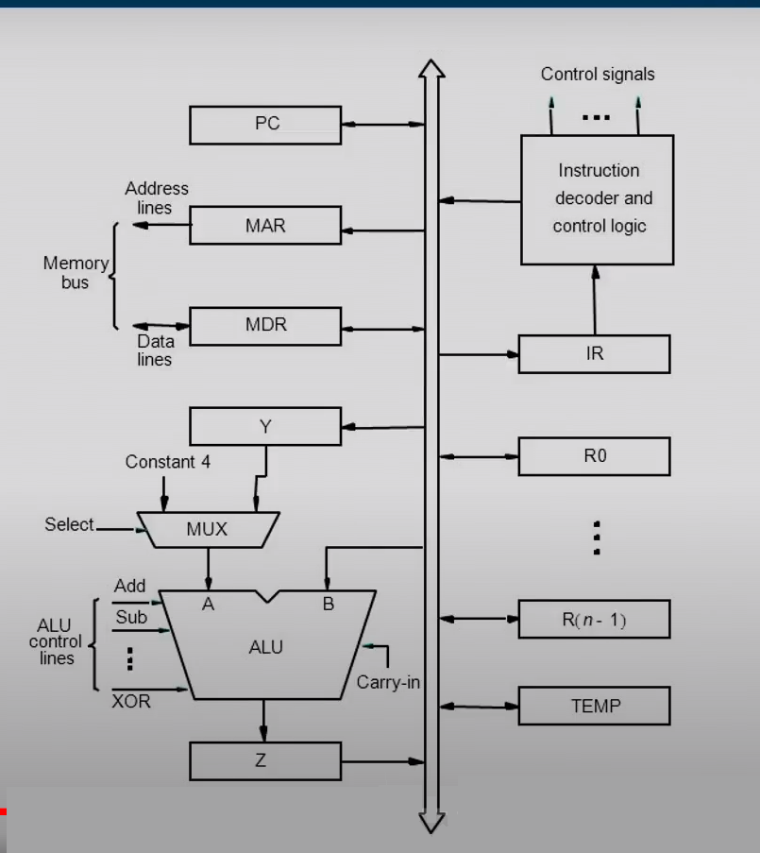
Single bus Organization of the datapath inside a processor

Slide 6
Execution of Complete Cycle
Example:
Add (R3),R1
Steps:
Fetch the instruction
Set the first operand(The contents of memory locations pointed by R3 )
Perform the addition
Store the results into R1

Slide 7
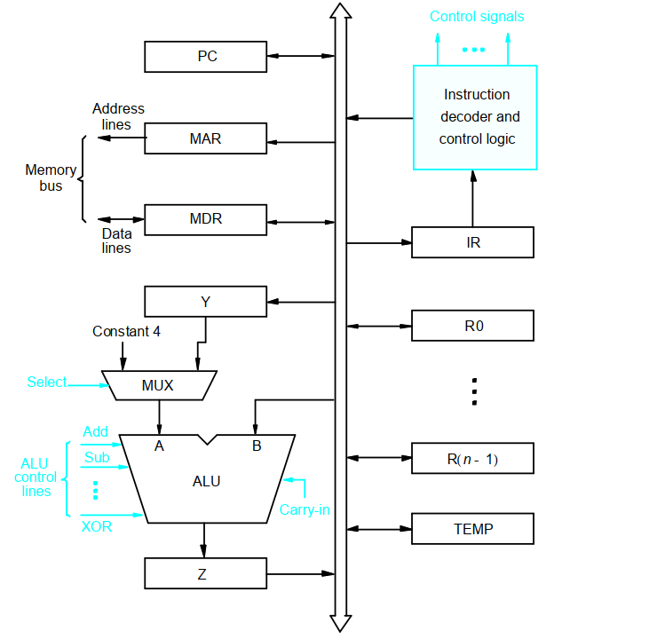
Execution of Complete Cycle
1000
.
Add (R3), R1
1008
R3
..
.
.
.
1008
10
R1
1004
20
1000
PC
Step |Action
PCout, MARin, Read, Select4, Add, Zin
Zout, PCin, WMFC
MDRout, IRin
R3out, MARin, Read
R1out, Yin, WMFC
MDRout, SelectY,Add,Zin
Zout, R1in, End

Slide 8
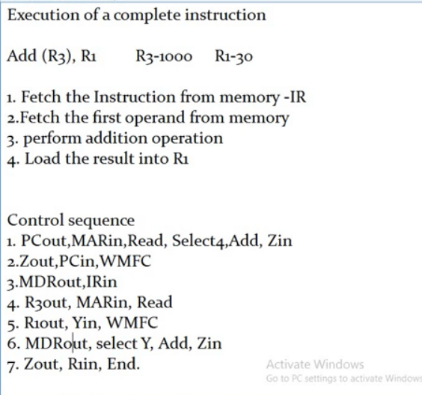

Slide 9
S.no | Control Sequence | Description
1 | PCout, MARin, Read, Select4, Add, Zin | The address of PC is read(out), and transferred to MAR(write), then MAR will read the Instruction from memory through memory bus. [Meanwhile to read the next instruction PC must be incremented] Then, select4 at MUX is selected and then added to the address of program counter, this will evaluate the address of next instruction and this address for now will be stored on Zin.
2 | Zout, PCin, WMFC | as Z is the temporoary register the address stored in Z has be written to program counter (PCin). WMFC(Waiting fr memory function complete) is signal which tell that above functions are completed and move to next.
3 | MDRout, IRin | Next, the Instruction read through memory bus and is stored on MDR(written). Then is transferred to Instruction register.
4 | R3out, MARin, Read | As R3 is indirect addressing register, it is having address instead of value. That address is given to MAR to read the value from that address through memory bus, data is read.
5 | R1out, Yin, WMFC | Value of R1 is transferred to Yin temporarily and the WMFC is checking if above function is complete then move to next.
6 | MDRout, SelectY, Add, Zin | MDR is having value of R3 and Y register is having R1 value. The both values are added through ALU and result is stored on Z temporarily.
7 | Zout, R1in, End | Z register will transfer the result to R1. And then END.

Slide 10
Reference
NPTEL IIT Guwahati: Instruction Execution Principles
https://youtu.be/UfdrYshNwnY
University of Babylon: http://www.uobabylon.edu.iq/eprints/paper_10_25484_124.pdf
Computer System Architecture - Morris Mano
William Stallings, Computer Organization and Architecture-Designing for Performance, Pearson Education.

Slide 11
Thank
You

Slide 12
Execution of Complete Cycle
Step |Action
PCout, MARin, Read, Select4, Add, Zin
Zout, PCin, WMFC
MDRout, IRin
R3out, MARin, Read
R1out, Yin, WMFC
MDRout, SelectY, Add, Zin
Zout, R1in, End

